Slide 1

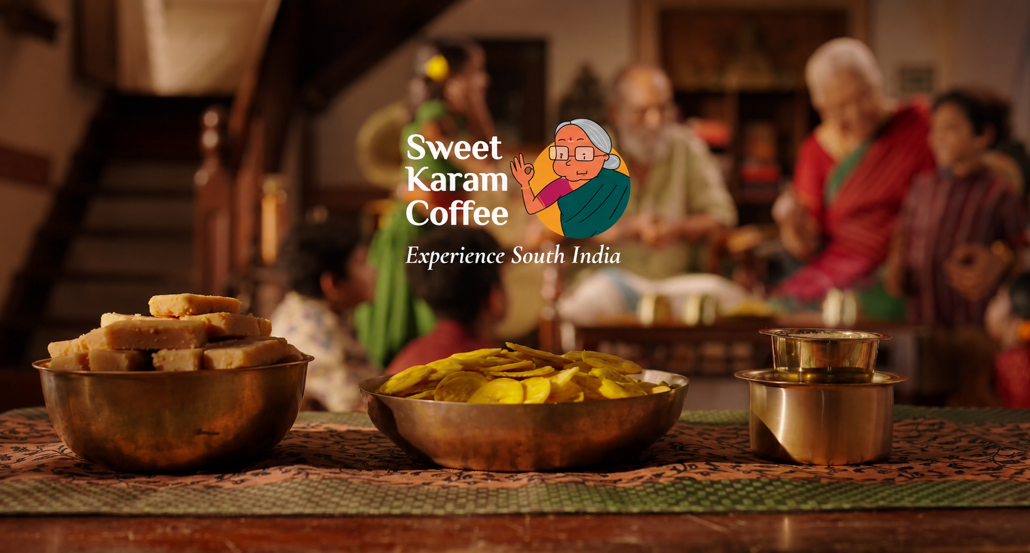
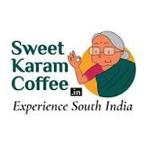
Presented by
Puja Karmakar
Batch ID- WA-471-ARSI-IT-DIMAWIAI-FEB-2026-2

Slide 2

ABOUT US
SWEET KARAM COFFEE
Sweet Karam Coffee is a fast-growing Indian food and beverage company that makes traditional South Indian sweets, snacks, and filter coffee.
"Authentic taste just like your grandma's preparation."

Slide 3
TABLE OF CONTENTS
4 PILLARS OF SEO
SEO PLAN SUMMARY ACTIVITIES
TARGET LOCATION
TARGET AUDIENCE
TOTAL ADDRESSABLE MARKET (FUNNEL)
COMPETITOR ANALYSIS
KEYWORD RESEARCH, CLUSTERING, MAPPING
STRATEGY/ROADMAP
BLOG CONTENT FOR SEO
PPC PART ANALYSIS
AD COPY DESIGN
TYPES OF AD
SOCIAL MEDIA TYPES OF AD
SOCIAL MEDIA ORGANIC WAY CONTENT CALENDER
BUSINESS UNDERSTANDING
BUSINESS OBJECTIVE
BUSINESS CHALLENGES
CURRENT SCENARIOS(SEO AUDIT)
OVERALL SEO AUDIT
DOMAIN AUTHORITY SCORE
WEBSITE TRAFFIC ANALYSIS
WEBSITE ORGANIC TRAFFIC ANALYSIS
PAGE RENDERING CHECK
PAGE SPEED CHECK MOBILE
PAGE SPEED CHECK DESKTOP
MOBILE FRIENDLINESS TEST
IMPROVEMENT RECOMMENDATIONS
SUGGESTIVE KEY IMPROVEMENT AREAS
EMAIL MARKETING
WHATSAPP MARKETING
SMS MARKETING
LANDING PAGE STRUCTURE
SEO KPIS TO TRACK
ORGANIZATION TEAM STRUCTURE
ACCOUNTABILITY
ACTIVITIES

Slide 4







BUSINESS UNDERSTANDING
Founded
2015
Founders
Nalini Parthiban & Anand Bharadwaj
Business Model
Direct-to-Consumer (D2C)
Products
South Indian snacks, sweets, filter coffee & traditional foods.
USP
Grandma-inspired recipes, Preservative-free products & authentic South Indian flavours
Audience
Across India & Internationally
MISSION: To Preserve the rich heritage of South Indian cuisine by offering high-quality, preservative-free products with authentic flavours and a seamless online shopping experience.

Slide 5








BUSINESS OBJECTIVES
1
Increase online sales
8
2
Enhance Shopping Experience
Expand Brand Reach
SWEET KARAM COFFEE
7
3
Increase Organic Website Traffic
Preserve Grandma’s Recipes
6
4
Deliver Authentic South Indian Flavours
Build Customer Trust & Loyalty
5
Offer Preservative-Free Products

Slide 6
BUSINESS CHALLENGES
SWEET KARAM COFFEE
Increase Online Visibility
Reach more potential customers through search engines and digital channels.
Convert Visitors into Customers
Improve the website journey and CTAs.
Strong competition
from other online sweets and snack brands.
MISSION: To Preserve the rich heritage of South Indian cuisine by offering high-quality, preservative-free products with authentic flavours and a seamless online shopping experience.

Slide 7
SEO AUDIT & GROWTH PLAN

Slide 8
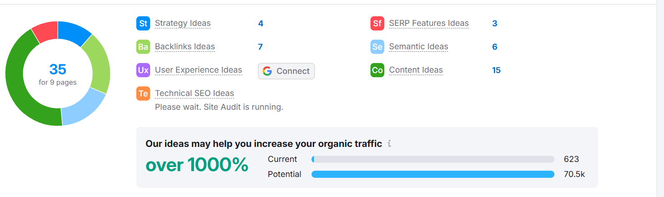
WEBSITE CURRENT SCENARIO
Right now, sweetkaramcoffee.in is doing okay in terms of Organic Traffic, with around 623 visits, but there’s a huge opportunity to grow. Based on the SEO check, the site could potentially reach over 70.5k visits.
There are 35 improvement ideas across different areas like content, backlinks, and semantic SEO, which are the biggest opportunities.
A few suggestions also touch on technical fixes, user experience, and strategy. With the right tweaks, sweetkaramcoffee.in could significantly boost its visibility and bring in a lot more traffic.

Slide 9
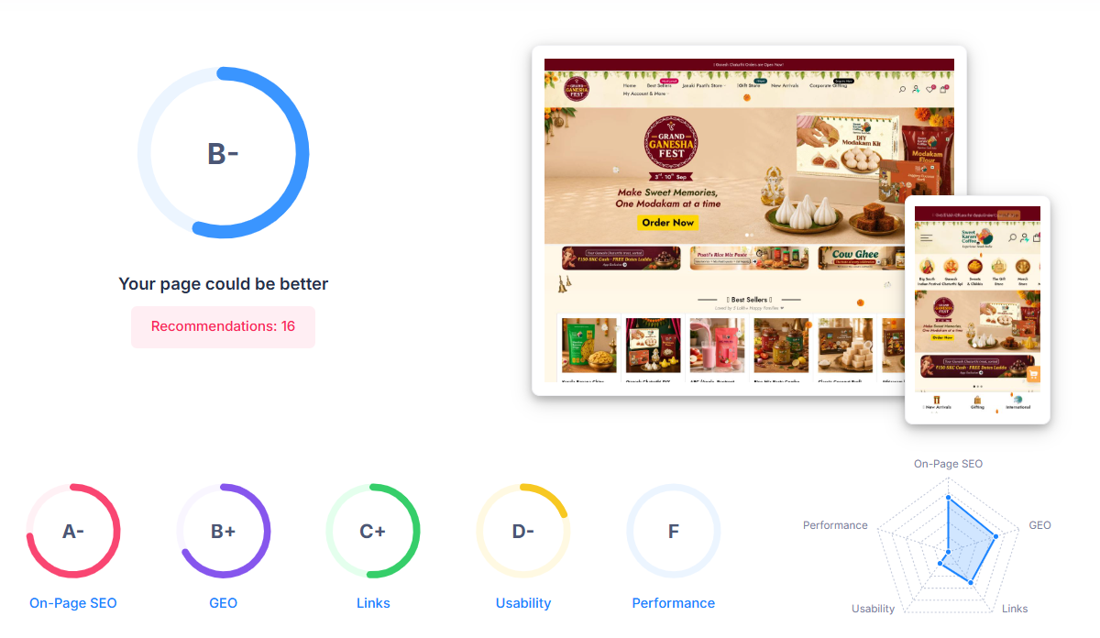
OVEALL SEO AUDIT
SWEET KARAM COFFEE
INSIGHTS
The website has several SEO issues that need improvement. On-Page SEO is good, but optimizing HTML tags, title tags, image alt text, and page speed can further improve website performance.
GEO (Generative Engine Optimization) is not fully optimized. AI-friendly content and structured content can improve visibility in AI-powered search results.
URL structure can be improved by using short, readable, and SEO-friendly URLs.
The website should optimize Core Web Vitals, improve usability, and fix technical SEO issues to achieve better rankings and user experience.
Please note that the data presented may change over time due to evolving metrics such as performance fluctuations, strategic adjustments, and external market dynamics.
Source: SEOptimer

Slide 10
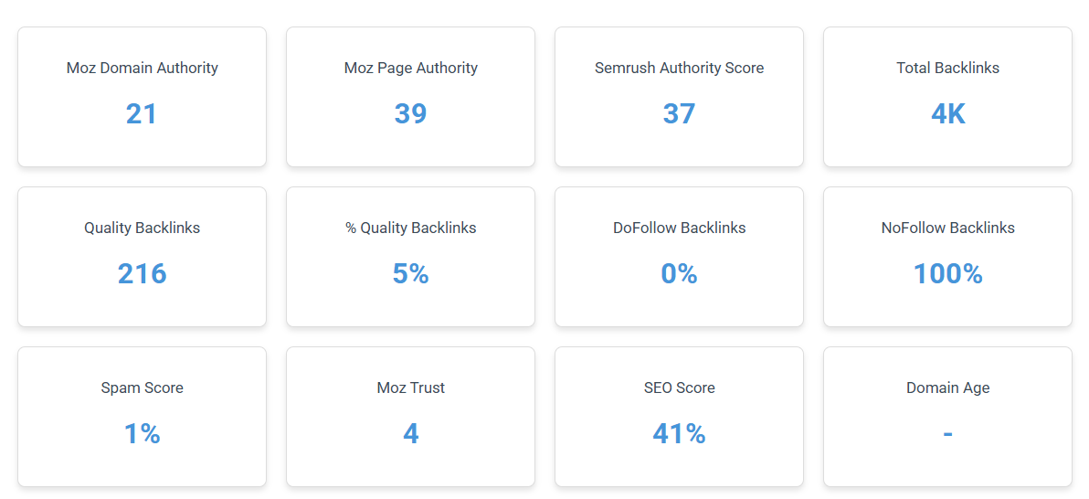
WEBSITE AUTHORITY
SWEET KARAM COFFEE
INSIGHTS
The current Domain Authority Score is 21
The current Page Authority Score is 39
The current Quality Backlinks of the Domain: 5%
The current spam score of the domain is 1%
Total backlinks of the domain: 4k
Please note that the data presented may change over time due to evolving metrics such as performance fluctuations, strategic adjustments, and external market dynamics.
Source: Website SEO Checker

Slide 11
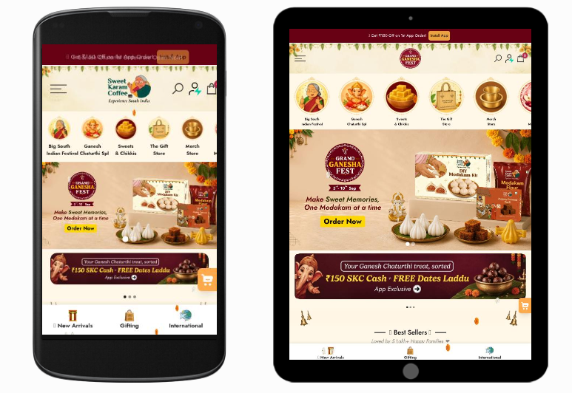
PAGE RENDERING CHECK
SWEET KARAM COFFEE
INSIGHTS
The Website is mobile-responsive, and the layout adapts well across different devices.
The site does not pass Google’s Core Web Vitals assessment; performance optimization is needed.
Optimizing Images, caching and overall page speed can improve Core Web Vitals, user experience and SEO performance.
Please note that the data presented may change over time due to evolving metrics such as performance fluctuations, strategic adjustments, and external market dynamics.
Source: SEOptimer

Slide 12
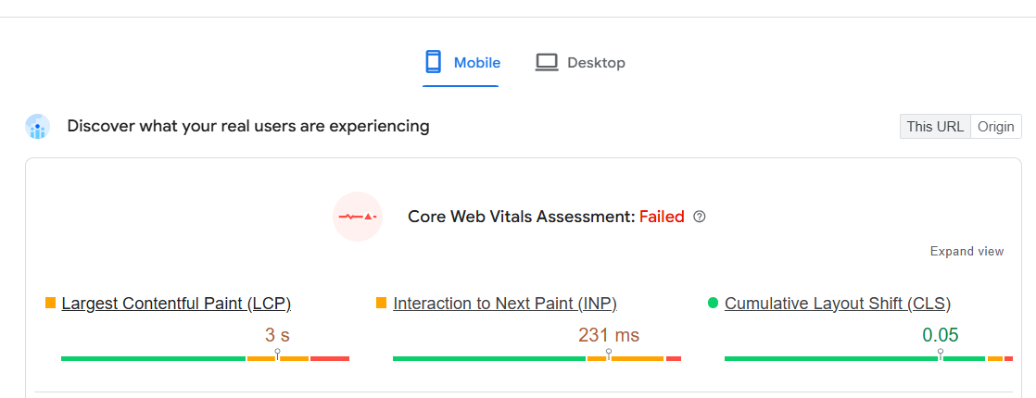
PAGE SPEED CHECK IN MOBILE
SWEET KARAM COFFEE
The 3 main metrics to passed core web vital is :
LCP( largest contentful paint):
Measures loading performance.
Good: <2.5 sec / =2.5 sec
2. INP (Interaction to Next Paint)
Measures Responsiveness
Good: <200 ms/ =200ms
3. CLS ( Cumulative Layout Shift)
Measures visual stability
Good: <0.1/=0.1
Please note that the data presented may change over time due to evolving metrics such as performance fluctuations, strategic adjustments, and external market dynamics.
Source: PageSpeed Insights
INSIGHTS
Here LCP is 3 sec, INP is 231ms, so both do not maintained the metrics. So the site did not pass Core Web Vitals.

Slide 13
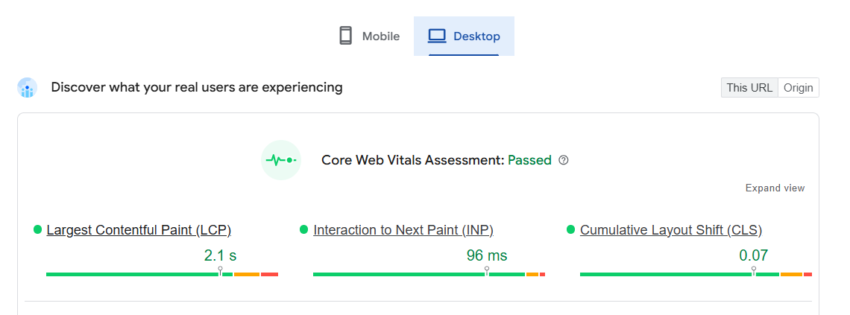
PAGE SPEED CHECK IN DESKTOP
SWEET KARAM COFFEE
INSIGHTS
Core Web Vitals: Passed – Overall website performance meets Google’s recommended standards.
LCP: 2.1s – Main content loads quickly and provides a good user experience.
INP: 96ms – Website responds very quickly to user interactions.
CLS: 0.07 – Page layout remains stable with minimal unexpected movement.
Overall: Good desktop performance with fast loading, responsive interactions, and stable page layout.
Please note that the data presented may change over time due to evolving metrics such as performance fluctuations, strategic adjustments, and external market dynamics.
Source: PageSpeed Insights

Slide 14
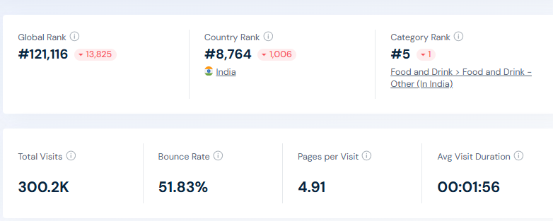
WEBSITE TRAFFIC ANALYSIS
SWEET KARAM COFFEE
INSIGHTS
Strong Website Reach: The website generated 300.2K total visits, indicating strong online visibility.
Global Visibility: Sweet Karam Coffee holds a Global Rank of 121,116, reflecting its position among websites worldwide.
Country Presence: The website ranks 8,764 nationally, showing a measurable presence within its target market.
Engagement Opportunity: With a 51.83% bounce rate, there is an opportunity to improve landing-page experience and visitor retention.
Healthy Browsing Depth: Visitors view an average of 4.51 pages per visit, suggesting good interest in the website content.
Please note that the data presented may change over time due to evolving metrics such as performance fluctuations, strategic adjustments, and external market dynamics.
Source: Similarweb

Slide 15
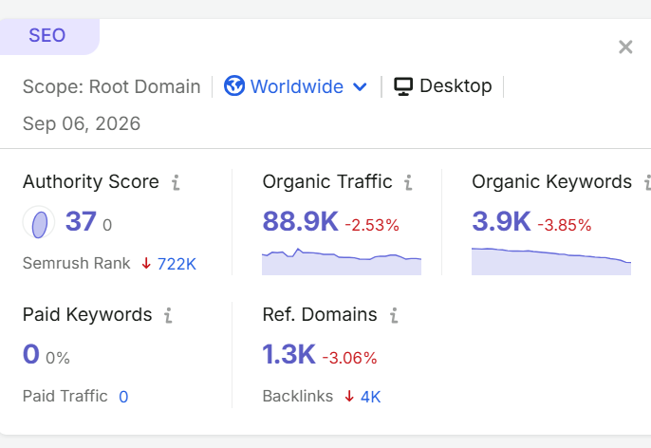
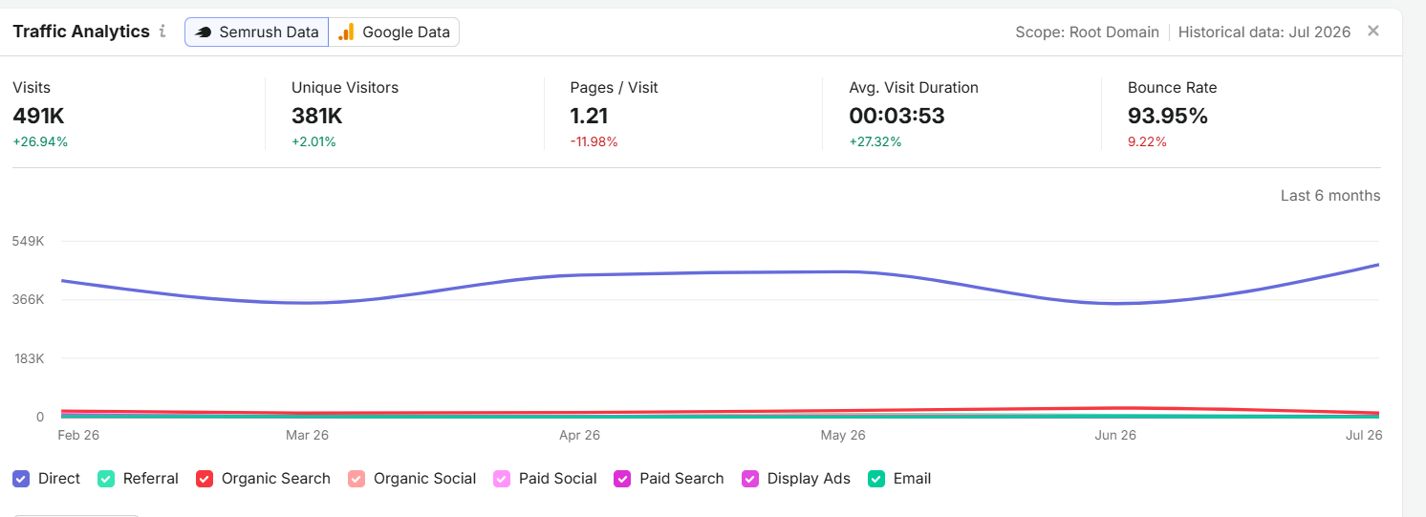
ORGANIC TRAFFIC ANALYSIS
SWEET KARAM COFFEE
Insights
The website gets around 88.9K organic visits, which shows that it is getting good traffic from search engines.
There are around 3.9K organic keywords helping people find the website through Google.
The Authority Score is 37, so there is still scope to improve the website’s SEO strength.
Organic traffic and keywords have slightly decreased, so improving website content and keyword targeting can help increase organic traffic.
The website has 1.3K referring domains, which shows that other websites are linking to it.
Please note that the data presented may change over time due to evolving metrics such as performance fluctuations, strategic adjustments, and external market dynamics.
Source: Semrush

Slide 16
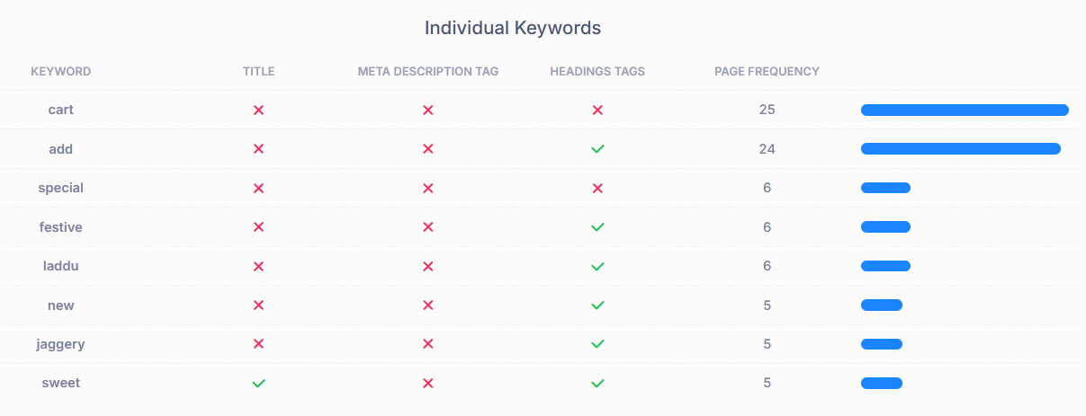
KEYWORD CONSISTENCY
SWEET KARAM COFFEE
Insights
This indicates that Page’s main keywords are not distributed well across important HTML tags. Page content should be focused around particular keywords we are likely to rank for. Ideally, these keywords should also be distributed across tags such as the title, meta and header tags.
Please note that the data presented may change over time due to evolving metrics such as performance fluctuations, strategic adjustments, and external market dynamics.
Source: SEOptimer

Slide 17
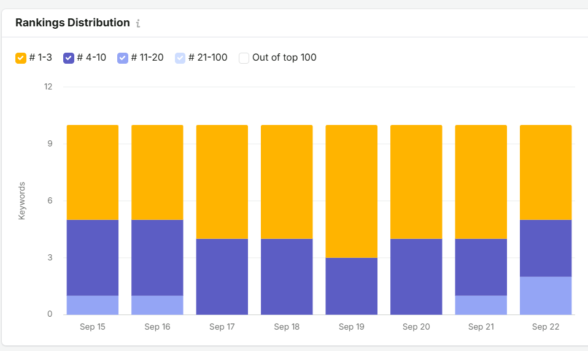
ORGANIC KEYWORD ANALYSIS
INSIGHTS
The website is ranking for around 10 keywords during the shown period.
A good number of keywords are ranking in the top 10 positions, which shows good search visibility.
Some keywords are ranking in positions 11–20, so there is a chance to move them to the first page.
A few keywords are also ranking in the 21–100 range, which need more SEO improvement.
The graph shows that the number of ranking keywords is fairly stable from September 15 to September 22.
Improving the keywords’ ranking outside the top 10 can help the website get more organic traffic and visibility.
Please note that the data presented may change over time due to evolving metrics such as performance fluctuations, strategic adjustments, and external market dynamics.
Source: SEMrush

Slide 18
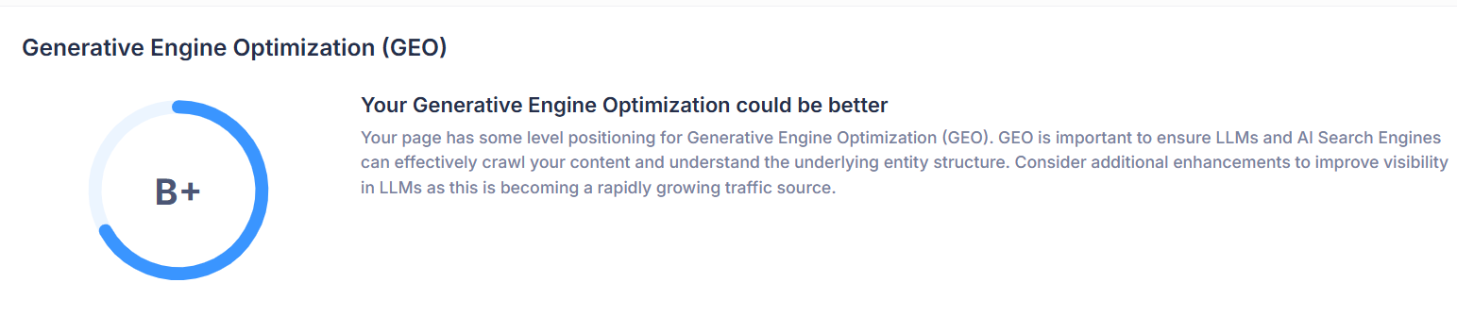
WEBSITE GEO DISTRIBUTION ANALYSIS
SWEET KARAM COFFEE
Insights
The website has a good foundation for Generative Engine Optimization.
Search engines can partially crawl and understand the website’s content and entity structure.
Additional GEO enhancements are required to strengthen visibility across AI-driven search platforms.
Improve structured content and clear entity relationships to help AI systems understand the brand and offerings.
GEO is increasingly important as AI-powered search becomes a growing source of website traffic.
Focus on structured data, authoritative content, FAQs, conversational queries, and entity-based optimization to improve it.
Please note that the data presented may change over time due to evolving metrics such as performance fluctuations, strategic adjustments, and external market dynamics.
Source: SEOptimer

Slide 19
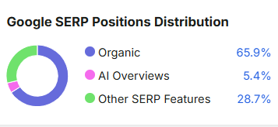
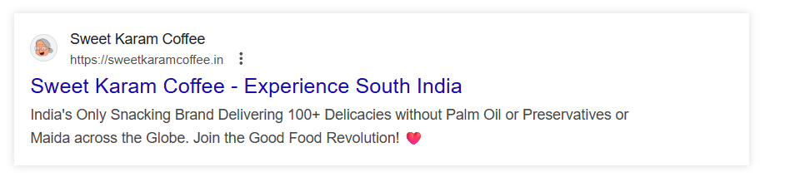
WEBSITE SERP ANALYSIS
SWEET KARAM COFFEE
Insights
Strong brand visibility with a clear brand name.
SEO-friendly page title highlighting South Indian positioning.
USP-focused meta description featuring 100+ delicacies and preservative-free products.
Global reach is clearly communicated.
Opportunity: Add high-intent keywords to improve CTR and rankings.
Please note that the data presented may change over time due to evolving metrics such as performance fluctuations, strategic adjustments, and external market dynamics.
Source: SEOptimer, SEMrush

Slide 20
IMPROVEMENT RECOMMENDATION
TITLE TAG: The title tag should be between 50 and 60 characters in length, but here the title tag was 43 characters. So it will be increased.
KEYWORD CONSISTENCY: The page's main keywords are not distributed well across the important HTML tags. The page content should be focused around particular keywords you would like to rank for. Ideally, these keywords should also be distributed across tags such as the title, meta and header tags.
AMOUNT OF CONTENT: This page has a low volume of text content, which search engines can interpret as “ thin content”. Word count: 888. It has been well researched that higher text content volume are related to better ranking ability in general.
IMAGE ALT ATTRIBUTES: This site has images on the page that are missing Alt Attributes. We found 143 images on the page, and 52 of them are missing the attribute. Image Alt Attributes are an often overlooked and simple way to signal to Search Engines what an image is about and help it rank in image search results.
RENDERED CONTENT (LLM READABILITY): page has a high level of rendering ( changes to the HTML). Rendering percentage: 42%. Dynamically rendering a lot of page content risks some important information being missed by LLMs that generally do not read this content.
Please note that the data presented may change over time due to evolving metrics such as performance fluctuations, strategic adjustments, and external market dynamics.
Source: SEOptimer

Slide 21
IMPROVEMENT RECOMMENDATION
FRIENDLY LINKS: Some of link URLs do not appear friendly to humans or search engines. We would recommend making URLs as readable as possible by reducing length, file names, code strings and special characters.
WEBSITE LOAD SPEED: Page loads slowly. Page load speed is critical to ensuring good user experience and is becoming a more important ranking factor. Load speed can be impacted by a multitude of factors; however and may need technical resources to investigate.
WEBSITE DOWNLOAD SIZE: Page is full size is quite large, which, regardless of other optimisations, can reduce load speed and impact user experience. A general rule is to keep your page under 5MB in total file size.
JAVASCRIPT ERROR: Page is reporting JavaScript errors during load. This could indicate that some required functionality on the page is failing or scripted may have coding problems
FACEBOOK PIXEL: We have not detected a Facebook Pixel on the page. Add this as soon as possible.
LOCAL BUSINESS SCHEMA: No Local Business Schema detected on the page. Add Local Business Schema.

Slide 22
SUGGESTIVE KEY IMPORTANT AREAS
Enhancing website loading speed and performance is a top priority, particularly for mobile devices, to improve both user experience and SEO rankings.
Significant improvements are needed in on-page SEO elements such as title tags, meta descriptions, H1 tag usage, and keyword placement to strengthen organic visibility.
The site requires richer and more optimized content on key pages to improve relevance, engagement, and keyword targeting.
Image optimization (alt attributes, compression, next-gen formats) should be implemented to reduce page weight and improve accessibility.
The site is responsive; mobile interactivity and usability should be enhanced to lower bounce rates and increase conversions.
Structured data/schema markup and local SEO enhancements (business address, phone number, geo-targeted keywords) are missing and should be added for better SERP visibility.

Slide 23
4 PILLERS OF SEO
Content creation & enhancement
Focus on high-quality.
Valuable content. Integrate relevant.
Targeted keywords: Maintain consistency through regular updates.
Backlink Strategy
Build authoritative, high-quality backlinks.
Target backlinks from niche-relevant sources.
Ensure a diverse and natural link profile
CRO & User Experience
Improve website navigation for better usability.
Optimize page load times for faster access.
Make sure the site is fully responsive on mobile devices
Analytics & Optimization
Monitor and evaluate traffic sources.
Refine user journey to boost conversions
Work on lowering the bounce rate

Slide 24

TARGET LOCATION
TARGET LOCATION STRATEGY
Tier 1 & Tier 2 cities
South Indian Diaspora Markets
High online-order potential areas
High-income & working-professional Zones
Tamil Nadu main market

Slide 25
TARGET LOCATION EXPANSION STRATEGY
SWEET KARAM COFFEE
What can be improved
Expand city-wise: Create a clear plan for Tier-1 and Tier-2 cities.
Stronger local targeting: Run location-based ads for high-potential cities.
Improve online reach: Target customers outside Tamil Nadu through SEO and social media.
Use customer data: Identify which cities generate the most orders and focus there.
Build local awareness: Use regional influencers and local campaigns when entering new markets.
What They’re Doing
Building their presence from Tamil Nadu.
Reaching customers through online channels.
Selling traditional South Indian coffee and food products.
Serving customers beyond their immediate local market.
Building the brand around traditional taste and South Indian identity.

Slide 26
TARGET AUDIENCE
SWEET KARAM COFFEE
South Indian Families
Families who enjoy traditional sweets, snacks and coffee.
Buy for everyday use and family occasions.
Prefer familiar and authentic flavours.
South Indians Living Away From Home
People who miss traditional South Indian food.
Looking for familiar tastes from home.
Customers living across India and abroad.
Young Professionals & Students
Looking for convenient snacks, coffee and ready-to-use products
Regular online shoppers
Prefer easy home delivery
Festive & Gifting Customers
Buy sweets, snacks and hampers for festivals and celebrations
Looking for traditional gifting options
Includes family, wedding and corporate gifting

Slide 27
TARGET AUDIENCE
SWEET KARAM COFFEE
Traditional Food Lovers
Enjoy authentic South Indian sweets, snacks and beverages
Interested in trying different regional products
Can buy across multiple product categories
Health & Quality Conscious Customers
Care about ingredients and product quality
Prefer traditional, homemade-style products
Willing to pay for better-quality food
Corporate & Bulk Buyers
Companies buying sweets, snacks and gift hampers
Mainly during festivals and special occasions
Opportunity for bulk and repeat orders

Slide 28
TOTAL ADDRESSABLE MARKET FUNNEL
SWEET KARAM COFFEE
TAM (Total Addressable Market) = The total potential market for packaged snacks and food products in India.
SAM (Serviceable Available Market) = The portion of TAM focused on ethnic snacks, traditional sweets and premium packaged regional foods that Sweet Karam Coffee can realistically serve.
SOM (Serviceable Obtainable Market) = The realistic share of SAM Sweet Karam Coffee can capture within 3–5 years through D2C, retail, digital marketing and geographic expansion.
MARKET CONTEXT
India has a large and growing market for packaged snacks and traditional foods.
Consumers are increasingly buying traditional food products through e-commerce and modern retail.
Sweet Karam Coffee already has 5 lakh+ customers, giving the brand a strong base to build on.

Slide 29
TOTAL ADDRESSABLE MARKET FUNNEL
SWEET KARAM COFFEE
TOTAL ADDRESSABLE MARKET (TAM)
₹1,00,000+ crore per year
This is the larger Indian market for traditional sweets, snacks, coffee and other packaged South Indian food products.
It includes customers buying these products for everyday consumption, festivals, gifting and special occasions.
SERVICEABLE AVAILABLE MARKET (SAM)
₹15,000–25,000 crore per year
This is the part of the market that Sweet Karam Coffee can realistically target with its current range of coffee, sweets, snacks, pickles, masalas and other traditional products.
The opportunity is across India through online sales, retail stores, marketplaces and gifting.
SERVICEABLE OBTAINABLE MARKET (SOM)
₹150–300 crore in 3–5 years
With stronger marketing, more customers, wider distribution and repeat purchases, Sweet Karam Coffee can aim to capture a small but meaningful share of its target market.
Growth can come from new customers, repeat orders, product expansion and festive/corporate gifting.

Slide 30
MICRO FUNNEL BREAKDOWN
SWEET KARAM COFFEE
Metric | Example Scenario | Numbers / Assumptions
Existing customer base | Sweet Karam Coffee has already served 5 lakh+ customers across India, giving the brand a strong base to build repeat purchases. | 5 lakh+ customers
Reachable audience via digital | Assume the brand can actively reach around 30% of its existing customers through WhatsApp, email, social media and remarketing. | ~1.5 lakh customers
Conversion/repeat purchase rate | Suppose 20% of the reachable customers place at least one repeat order during the year. | ~30,000 orders
Avg order value (AOV) | Assume an average order value of around ₹600–800, based on the current mix of snacks, sweets, coffee and combo products on the website. | ₹700 average

Slide 31
COMPETITOR ANALYSIS
MARKET REACH
Extremely strong online presence focused on traditional Tamil Nadu and South Indian sweets and snacks, with shipping within Tamil Nadu, other states, and internationally.
BRAND PERCEPTION
Positioned on authentic Tamil Nadu village snacks, sweets, nostalgia and traditional recipes.
PETTIKADAI
TARGET KEYWORDS
Traditional Tamil sweets, Tamil snacks online, South Indian snacks, Athirasam, traditional sweets online.
KEY STRENGTH
Strong niche positioning around native Tamil products with a clear online-shopping focus.
More concentrated on Tamil/South Indian traditional products, allowing Sweet Karam Coffee to build a broader regional and ingredient-led proposition.
KEY WEAKNESS

Slide 32
COMPETITOR ANALYSIS
MARKET REACH
Strong South Indian sweets brand with online ordering, pan-India shipping, festive gifting and interstate/bulk orders.
BRAND PERCEPTION
Strongly associated with traditional sweets, especially its signature Mysurpa.
SRI KRISHNA SWEETS
Mysurpa, Mysore Pak, South Indian sweets, Kai Murukku, traditional sweets, festive sweets.
TARGET KEYWORDS
Strong signature-product positioning around Mysurpa plus a wide range of sweets and savouries.
KEY STRENGTH
Strong product-led positioning creates an opportunity for Sweet Karam Coffee to differentiate through broader regional snack storytelling and ingredient-focused USPs.
KEY WEAKNESS

Slide 33
COMPETITOR ANALYSIS
MARKET REACH
Indian Snacks House mainly reaches customers through its online store and focuses on traditional Indian snacks and sweets.
BRAND PERCEPTION
This brand focuses on traditional tasty Indian snacks.
INDIAN SNACKS HOUSE
Indian snacks online, South Indian snacks, traditional snacks, Indian sweets, banana chips, murukku.
TARGET KEYWORDS
KEY STRENGTH
It has a clear focus on traditional snacks and sweets.
Its brand identity is less focused on a specific unique benefit, giving Sweet Karam Coffee a chance to highlight its health-conscious products.
KEY WEAKNESS

Slide 34
COMPETITOR ANALYSIS
MARKET REACH
The brand mainly sells Mysore Pak and other traditional sweets online and reaches customers across India.
BRAND PERCEPTION
It is strongly connected with Mysore Pak and traditional Mysuru sweets.
WORLD OF MYSOREPAK
TARGET KEYWORDS
Mysore Pak online, Mysuru sweets, authentic Mysore Pak, ghee Mysore Pak, traditional sweets.
KEY STRENGTH
Its biggest strength is its strong focus on Mysore Pak.
Its product range is more limited compared with Sweet Karam Coffee's wider South Indian range.
KEY WEAKNESS

Slide 35
COMPETITOR ANALYSIS
MARKET REACH
Delight Foods sells different types of Indian sweets, snacks and regional food products online
BRAND PERCEPTION
It is positioned as a brand for people who want to discover traditional food from different parts of India.
DELIGHTS FOOD
TARGET KEYWORDS
Indian sweets online, Indian snacks online, traditional Indian food, South Indian snacks, regional Indian food.
KEY STRENGTH
It has a wide range of products from different regions.
It covers many regions, but it has less focus on South Indian food compared with Sweet Karam Coffee.
KEY WEAKNESS

Slide 36
COMPETITOR ANALYSIS
MARKET REACH
Native Special sells traditional sweets, snacks and other South Indian products online. It also serves customers outside India.
BRAND PERCEPTION
The brand is known for traditional and regional Tamil food.
NATIVE SPECIAL
Tamil sweets online, South Indian sweets, traditional Tamil snacks, Tirunelveli Halwa, Palkova.
TARGET KEYWORDS
KEY STRENGTH
Its main strengths are its regional products and traditional flavours.
It focuses more on products from Tamil Nadu, while Sweet Karam Coffee offers a broader South Indian product range.
KEY WEAKNESS

Slide 37
KEYWORD RESEARCH, CLUSTERING & MAPPING

Slide 38
KEYWORD RESEARCH
SWEET KARAM COFFEE
ABC Drink
Kerala banana chips
Karupatti in English
Milk mix
South Indian snacks
Sweet karam coffee
Filter Coffee
Coffee Powder
Indian snacks
Winter Season Food
Sweet karam coffee snacks
South snacks
Chakli
South Indian Snacks

Slide 39
KEYWORD RESEARCH- INFORMATIONAL
SWEET KARAM COFFEE
KEYWORD | SEARCH VOLUME | COMPITITION
Jaggery Sweets | 1k-10k | High
Mysore Pak | 10k-100k | Medium
Kai Murukku | 1k-10k | High
Traditional South Indian Snacks | 100-1k | Medium
Types of Murukku | 100-1k | Low
Filter Coffee | 10k-100k | Medium

Slide 40
KEYWORD RESEARCH- COMMERCIAL
SWEET KARAM COFFEE
KEYWORD | SEARCH VOLUME | COMPITITION
Best Snacks | 1k-10k | Medium
Good Snacks | 100-1k | Low
Filter Coffee | 10k-100k | Medium
Jaggery sweets | 1k-10k | High
South Indian Diwali Sweets | 100-1k | Low
Healthy Indian Deserts | 100-1k | Low

Slide 41
KEYWORD RESEARCH- TRANSACTIONAL
SWEET KARAM COFFEE
KEYWORD | SEARCH VOLUME | COMPITITION
Banana Chips online | 100-1k | High
Mysore pak Online | 1k-10k | High
Kai murukku online | 100-1k | High
Mysore pak sweet price | 100-1k | Medium
Buy Murukku Online | 100-1k | High
South Indian Sweets Home Delivery | 100-1k | High

Slide 42
KEYWORD MAPPING
SWEET KARAM COFFEE
HOME PAGE
South Indian Sweets Online.
South Indian Snacks Online
Traditional South Indian Food Online
Authentic South Indian Sweets & Snacks
Buy Indian Sweets Online
South Indian Snacks & Sweets Delivery
PRODUCT PAGE
Buy Mysore Pak Online
Buy Kai Murukku Online
Buy South Indian Snacks Online
Buy Banana Chips Online
Buy Jaggery Sweets Online
Buy Filter Coffee Online
Buy ABC Milk Mix Online
Buy South Indian Sweets Online
Buy Kerala Banana Chips Online
Buy Traditional South Indian Sweets Online

Slide 43
KEYWORD MAPPING
SWEET KARAM COFFEE
What is Mysore Pak?
What is Kai Murukku?
Traditional South Indian Sweets and Their History
Types of South Indian Snacks
Traditional Jaggery Sweets from South India
Best South Indian Snacks for Evening Coffee
South Indian Snacks for Tea Time
Traditional Sweets for Indian Festivals
Difference Between Murukku and Kai Murukku
Why Jaggery is Used in Traditional Indian Sweets
BLOG PAGE
Home Page → Broad, high-volume keywords (commercial + transactional mix).
Product Pages → Transactional keywords (specific products + “price/buy online”).
Blog → Informational keywords (guides, comparisons, how-to content).

Slide 44
KEYWORD CLUSTER
SWEET KARAM COFFEE
CLUSTER NAME | PRIMARY KEYWORD | SECONDARY KEYWORD
South Indian Sweets | South Indian sweets | Traditional south indian sweets, south indian sweets online, mysore pak
South Indian Snacks | South Indian Snacks | Traditional South Indian snacks, murukku, kai murukku
Jaggery Sweets | Jaggery Sweets | Jaggery-based sweets, sweets without white sugar, traditional jaggery sweets.
Regional Snacks | Traditional Indian snacks | kerala banana chips, andhra murukku, onion kodubale, regional snacks
Product / Transactional | Buy South Indian sweets online | Buy mysore pak online, buy athirasam online, buy murukku online, buy banana chips online
Coffee & Milk Mixes | Filter coffee | South Indian filter coffee, filter coffee powder, instant filter coffee, milk mix
Health / Ingredients | Jaggery based sweets | No white sugar sweets, no maida snacks, no palm oil snacks, preservative free sweets

Slide 45
BLOG CONTENT FOR SEO
SWEET KARAM COFFEE
Use English and regional keywords naturally in blog content.
Create FAQ-based blogs around questions customers commonly search for.
Add internal links from blogs to relevant product pages to encourage purchases.
Focus on long-tail keywords such as “ classic South Indian snacks for tea-time breaks”.
Cover topics based on what customers actually want to know, eat and buy.

Slide 46
SOCIAL MEDIA CALENDAR-SEPTEMBER
DATE | PLATFORM | THEME | CAPTION WITH HASHTAGS | CALL TO ACTION
Sep 1, Tues | Instagram, Facebook, YouTube | Monsoon Cravings Best Sellers | Monsoon cravings? Here’s what to add to your cart before the sale ends. #sweetkaramcoffee #MonsoonCravings #monsoonSnacks #SouthIndianfood | Add to cart
Sep 3, Thu | Instagram reels, YouTube shorts | Product Spotlights | Best South Indian Treats for Rainy Days #sweetkaramcoffee #MonsoonCravings #MonsoonSnacks #SouthIndianfood | Shop now
Sep 5, Sat | Facebook, Instagram, YouTube | Brand Story | Why Good Things don’t look perfect #SouthIndianfood #sweetkaramcoffee # SouthIndianSnacks | Read more
Sep 7, Mon | Instagram reels, Facebook, YouTube | Regional Flevour | How to make filter coffee with a filter at home #sweetkaramcoffee #filtercoffee #Coffeeathome | Try it Today
Sep 10, Thu | YouTube, Instagram reels, Facebook reels | Best Sellers | Peanut Chikki Benefits: Why It’s a Timeless Indian Sweet #sweetkaramcoffee #peanutchikki #Indiansweets | Add to Cart
Sep 12, Sat | YouTube, Instagram, Facebook | Ganesh Chaturthi Special | Why 21 Modaks Are Offered to Ganesha – The Story That Explains It. #sweetkaramcoffee #GaneshChaturthi #Festivesweets | Shop Now
Sep 14, Mon | Instagram reels, YouTube, Facebook story | Thali Ideas | Simple and traditional thali ideas for a special family celebration #sweetkaramcoffee #Thaliideas #traditionalfoods #SouthIndianSweets | Read More

Slide 47
SOCIAL MEDIA CALENDAR-SEPTEMBER
DATE | PLATFORM | THEME | CAPTION WITH HASHTAGS | CALL TO ACTION
Sep 16, Wed | Instagram, Facebook, YouTube | Quick recipes | Want to make authentic filter coffee at home? Follow this simple steps. #Filtercoffee #Coffeerecipes #sweetkaramcoffee #SounthIndiansnacks | Watch Now
Sep 18, Fri | Instagram reels, YouTube shorts | Best sellers | Rich, traditional and loved! Mysore Pak is always a good idea. #sweetkaramcoffee #SounthIndiansnacks #MysorePak | Add to cart
Sep 20, Sun | Facebook, Instagram, YouTube | Brand Story | Stories of goodness, told with love! #sweetkaramcoffee #SounthIndiansnacks #BrandStory | Watch Now
Sep 22,Tues | Instagram reels, Facebook, YouTube | Product Spotlights | Types of laddu from classic to modern variations. #sweetkaramcoffee #SounthIndiansnacks | Shop Now
Sep 25, Fri | YouTube, Instagram reels, Facebook reels | Regional Flavour | Mango specials craving sorted, from melt-in-your-mouth sweets! #sweetkaramcoffee #SounthIndiansnacks | Add to cart
Sep 27, Sun | YouTube, Instagram, Facebook | Customer Review | Trusted by 5 lakh+ customers across India #sweetkaramcoffee #SounthIndiansnacks #Customerreviews | Download the app
Sep 30, Wed | Instagram reels, YouTube, Facebook story | Festival | Celebrate the festive season with Our Special DIY Modakam Collection #sweetkaramcoffee #SounthIndiansnacks | Shop Now

Slide 48
PPC PART ANALYSIS

Slide 49

GOOGLE SEARCH ADS CAMPAIGN
CAMPAIGN SETTINGS
Campaign Name: Sweet Karam Coffee Search Ads
Campaign Objective: Create a campaign without guidance
Campaign Goal: Sales (Increase Online sales)
Campaign Type: Search
Location: India
Ad Schedule: 8 am-10 pm
Languages: All languages
Bidding Strategy: Maximize Conversions
Audience: Online shoppers, coffee lovers, food lovers, gift buyers, Families, Work Professionals.
Device: Prioritize mobile
Daily Budget: 1500/day
AD GROUP & AD COPY
Ad Group Name: Sweet Karam Coffee- Ad Group 1
Headlines
Authentic South Indian Snacks
Grandma’s Traditional Recipes
Fast delivery across India
Shop Janaki Patti’s special
Healthy & Preservative-Free
Traditional sweets
Description
Experience authentic South Indian Snacks, sweets, and filter coffee made using grandma-inspired recipes.
Traditional recipes, preservative-free products
Keywords
South Indian Sweets
Filter Coffee Online
Buy Murukku
Sweet Karam Coffee
Traditional South Indian Snacks
Audience Targeting
Online shoppers
Coffee Lovers
Food lovers
Gift Buyers
Age Groups: 18-55 yrs.
Interests: Food & Beverages, Online shopping, South Indian Cuisine.
AD EXTENSIONS
Call Extension: 7330068306(Get in touch)
Location Extension: Chennai, Tamil Nadu
Sitelink Extension: Best sellers, Janaki paati’s store, New arrivals, Gift store
Structured Snippets: snacks, sweets, filter coffee, gift boxes
Callout Extension: preservative- free, fast delivery, authentic taste, secure payment

Slide 50
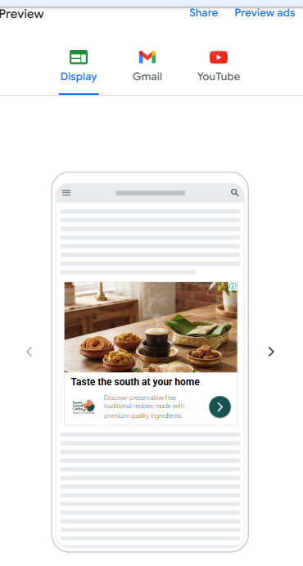
GOOGLE DISPLAY ADS CAMPAIGN
CAMPAIGN SETTINGS
Campaign Name: Sweet Karam Coffee Display Ads
Campaign Objective: Create a campaign without guidance
Campaign Goal: Sales (Increase Online sales)
Campaign Type: Display
Location: India
Ad Schedule: 8 am-10 pm
Languages: All languages
Bidding Strategy: Maximize Conversions
Audience: Online shoppers, coffee lovers, food lovers, gift buyers, Families, Work Professionals.
Device: Prioritize mobile
Daily Budget: 100/day
Ads creation
URL: https://sweetkaramcoffee.in/collections/all
Responsive Display Ads (Image, Logo, Video)
Headline 1: Authentic South Indian Snacks
Headline 2: Grandma’s Special Recipes
Headline 3: Taste the South at your home
Headline 4: Shop Janaki Patti’s Store
Headline 5: Premium Filter Coffee
Long Headline: Enjoy Grandma’s recipes with healthy, preservative-free Goodness.
Description 1: Enjoy Authentic South Indian snacks, sweets, and filter coffee delivered to your home
Description 2: Discover preservative-free traditional recipes made with premium-quality ingredients
Description 3: Shop Authentic South Indian snacks, gift boxes, and premium filter coffee online
Call to Action: Shop Now
SWEET KARAM COFFEE
Audience Targeting
Online shoppers
Coffee Lovers
Food lovers
Gift Buyers
Age Groups: 18-55 yrs.
Interests: Food & Beverages, Online shopping, South Indian Cuisine.

Slide 51
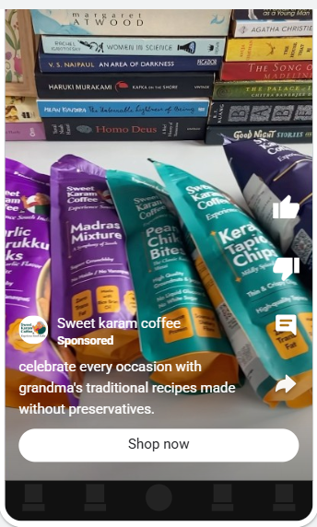
GOOGLE VIDEO ADS CAMPAIGN
SWEET KARAM COFFEE
CAMPAIGN SETTINGS
Campaign Name: Sweet Karam Coffee Video Ads
Campaign Objective: Create a campaign without guidance
Campaign Goal: Sales (Increase Online sales)
Campaign Type: Video
Location: India
Ad Schedule: 8 am-10 pm
Languages: All languages
Bidding Strategy: Maximize Conversions
Audience: Online shoppers, coffee lovers, food lovers, gift buyers, Families, Work Professionals.
Device: Prioritize mobile
Daily Budget: 100/day
Audience Targeting
Online shoppers
Coffee Lovers
Food lovers
Gift Buyers
Age Groups: 18-55 yrs.
Interests: Food & Beverages, Online shopping, South Indian Cuisine.
CTA: Shop Now

Slide 52

META AWARENESS AD CAMPAIGN
CAMPAIGN SETTINGS
Campaign Buying type: Auction
Campaign objective: Awareness
Campaign Name: Sweet Karam Coffee meta awareness campaign
Budget Strategy: Ad set budget
Facebook page: Sweet Karam Coffee
Bid strategy: Highest volume
Frequency control : Cap( 2times in every 7 days)
Rule set: Location
Budget and schedule:
Budget strategy: Daily budget (200/-)
Start date: 4th Sep 2026, 8 am
Location: India
Minimum age: 18
Audience: Sweet karam coffee audience( food lover, coffee lover, families, working professional, gift buyers, online shoppers)
Languages: all languages
META ADS
Ad setup:
Create ad
Format: Single image or video
Ad Creative:
Headline: Experience the Authentic taste of South Indian snacks & filter coffee
Media:
Feeds, ads on Facebook Reels.
Story status, Reels, in- stream for Reels, search results, app and sites.
Facebook Search results.
CTA: LEARN MORE

Slide 53
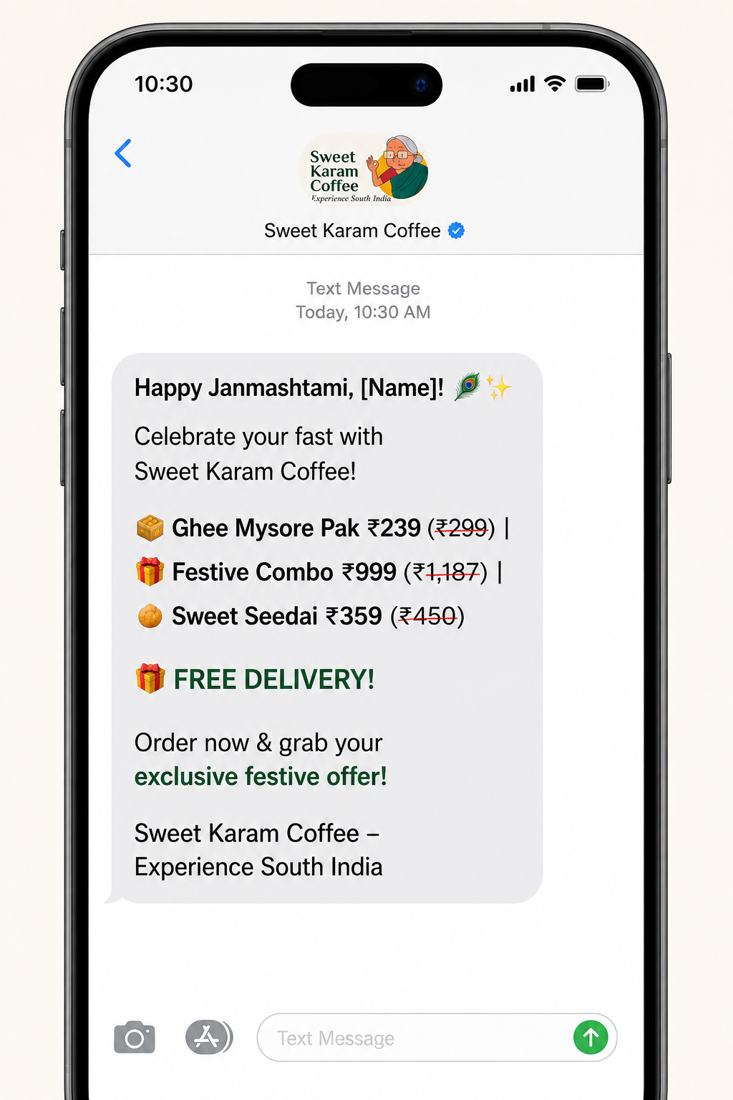
SMS MARKETING CAMPAIGN
SWEET KARAM COFFEE
Happy Janmashtami, [Name]
Celebrate your fast with Sweet Karam Coffee!
Ghee Mysore Pak at ₹239 (₹299)
Festive Combo at ₹999 (₹1,187)
Sweet Seedai at ₹359 (₹450)
FREE DELIVERY!
Order now & grab your exclusive festive offer!
Sweet Karam Coffee – Experience South India
Source: Chatgpt

Slide 54
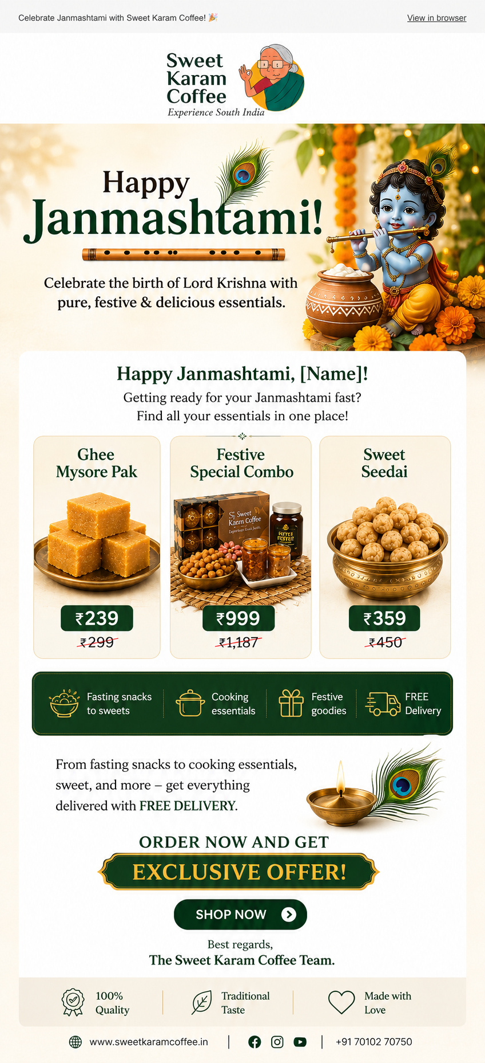
EMAIL MARKETING CAMPAIGN
Happy Janmashtami, [ Name]
Getting ready for your Janmashtami fast?
Find all your essentials in one place!
Ghee Mysore pak at ₹239 ₹299
Festive special combo at ₹999 ₹1187
Sweet Seedai at ₹ 359 ₹450
From fasting snacks to cooking essentials, sweet, and more get everything delivered in free delivery.
Order now and get exclusive offer
Best regards,
The Sweet Karam Coffee Team.
Source: Chatgpt

Slide 55
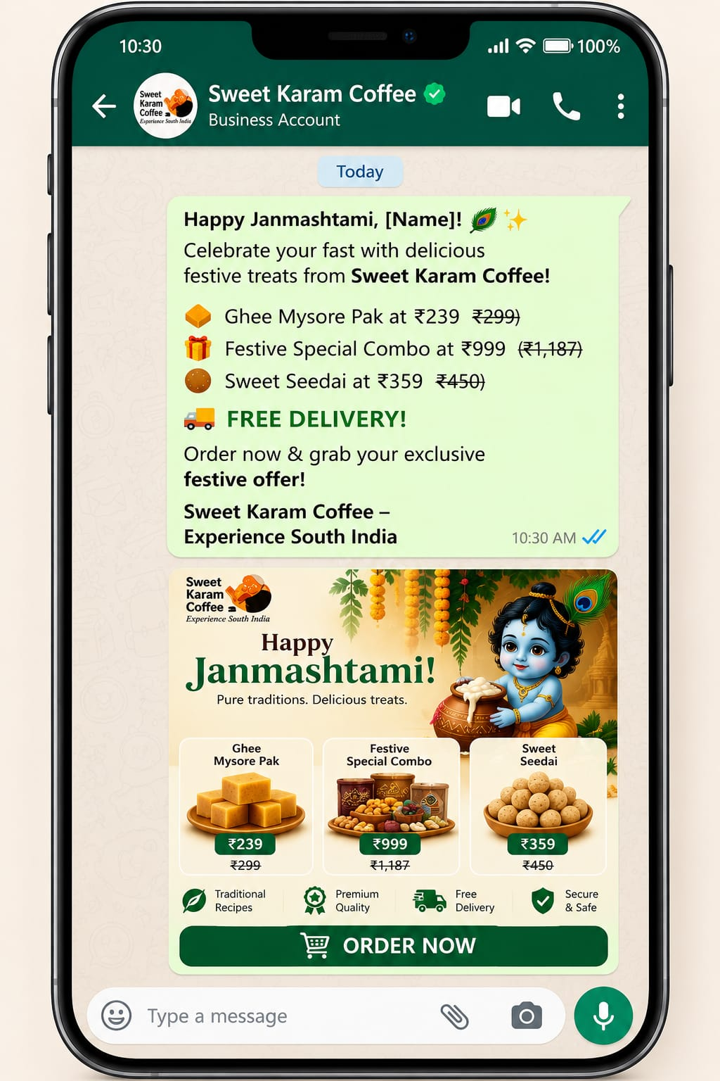
WhatsApp Marketing
SWEET KARAM COFFEE
Happy Janmashtami, [Name]
Celebrate your fast with Sweet Karam Coffee!
Ghee Mysore Pak at ₹239 (₹299)
Festive Combo at ₹999 (₹1,187)
Sweet Seedai at ₹359 (₹450)
FREE DELIVERY!
Order now & grab your exclusive festive offer!
Sweet Karam Coffee – Experience South India

Slide 56
LANDING PAGE STRUCTURE

Slide 57
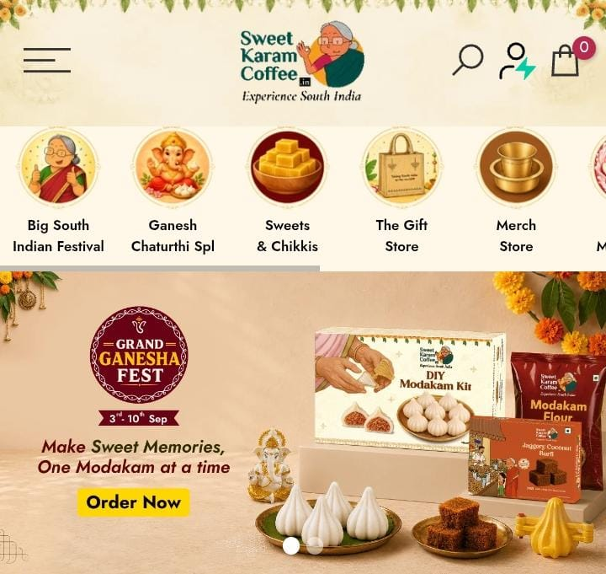
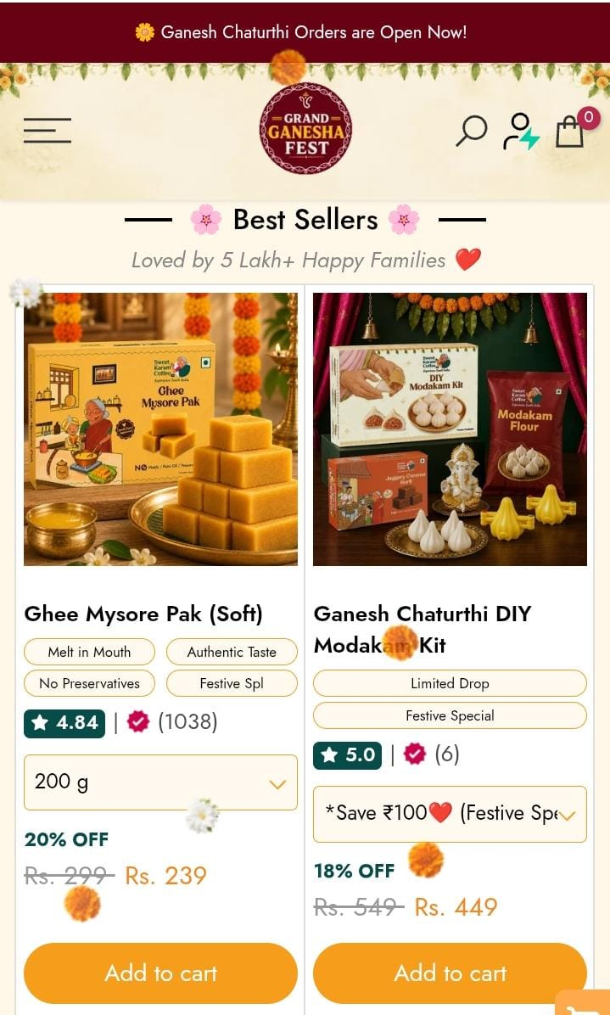
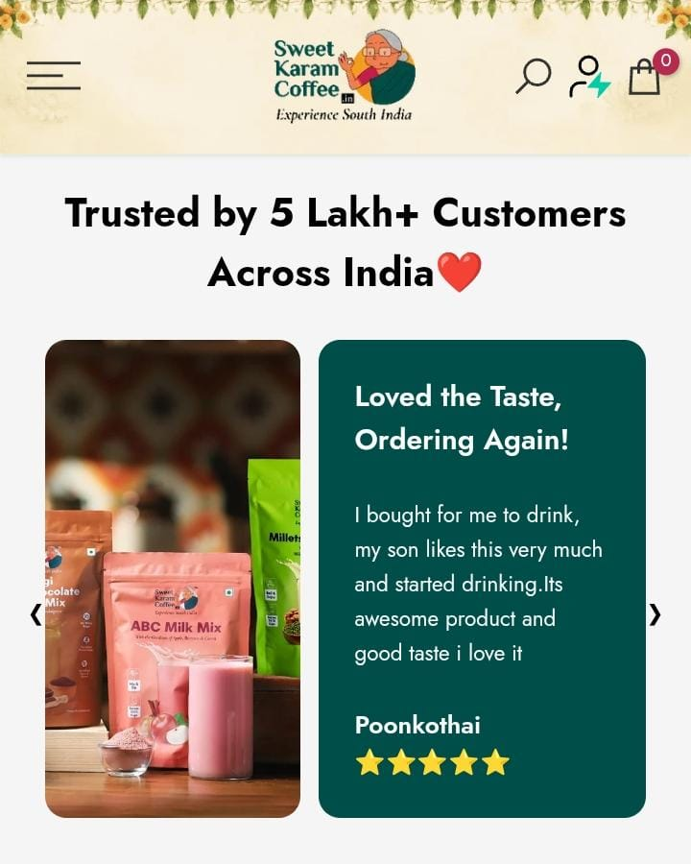
LANDING PAGE STRUCTURE
SECTION | CONTENT IDEA
Hero Section | Headline: Make sweet Memories, One Modakam at a time. Hero Banner: Grand Ganesha Fest CTA Button: Order Now
Best Sellers | Ghee Mysore pak ( Soft) Ganesh Chaturthi DIY Modakam Kit Classic Coconut Barfi
Trust and social proof | Trusted by 5 lakh+ happy Customers across India
Customer Reviews | Display Customer testimonials Rating & Reviews

Slide 58
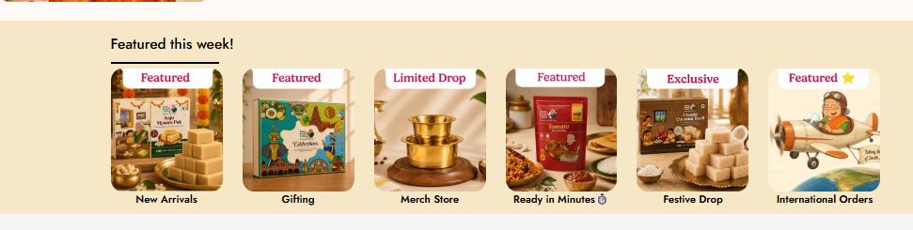
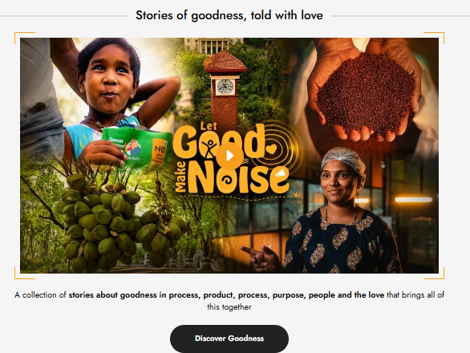
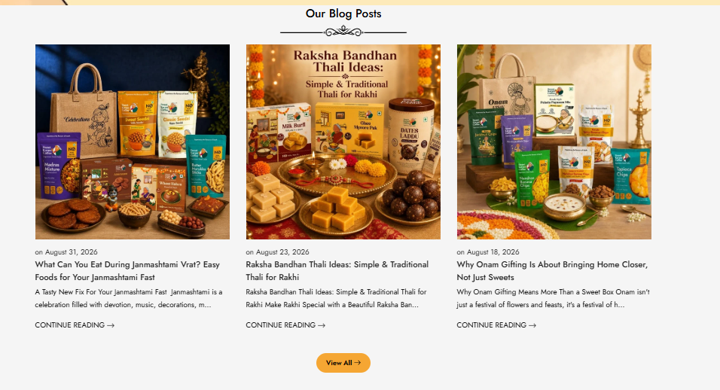
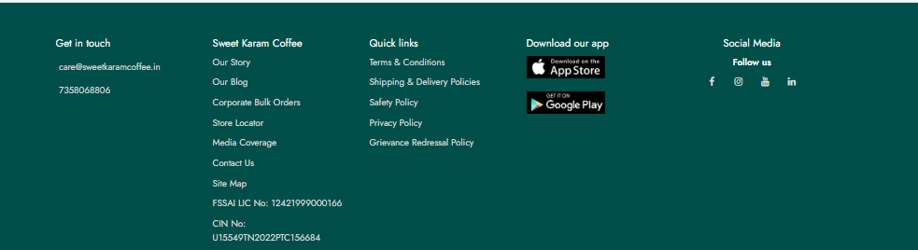
LANDING PAGE STRUCTURE
SECTION | CONTENT IDEA
Featured Categories | Highlighted main categories. Easy navigation for users.
Brand Stories | Shared Brand story. Connect emotionally with customers.
Blog Section | Shared Blog, recipes and festival contents. Educate and engage users.
Contact | App download and social media links Company info
SWEET KARAM COFFEE

Slide 59
KPIs, accountability & team Structure

Slide 60
KPIs USED IN JOURNEY
Journey Stage | Category | Key Performance Indicators
Awareness | Reach & Visibility | Website Traffic + Ad Reach. Social Media Reach/Impressions. Brand Search Volume.
Interest | Engagement & Curiosity | Time on Site + Ad Click-Through Rate (CTR). Blog Reads / Recipe Views Video Views on Modakam Making Content
Consideration | Intent | Add-to-Cart Rate/ Wishlist Rate FAQ + Call-to-Action Clicks (Order Now / Sign Up)
Conversion | Transactions | Orders Placed (e.g Kai murukku, ABC milk mix) Cost per Conversion (CPC) Conversion Rate (Website / App)
Delivery & Fulfilment | Experience | Order Fulfilment Rate Refund/Return Rate Delivery Turnaround Time
Retention | Repeat Use | Repeat Purchase Rate Email/WhatsApp Engagement Subscription/Reward Program Usage
Advocacy | Reputation | Customer Reviews & Ratings User Referral Participation

Slide 61
SEO KPIs to TRACK
SWEET KARAM COFFEE
Organic Traffic
Conversion Rate
Crawlability
Keyword Rankings
Quality of Inbound Links
Local SEO Metrics
Click-Through rate (CTR)
UX Performance
Site Ranking
Bounce Rate
Page Speed
Domain Authority
Session Duration & Pages / Session
Indexed pages
Content Performance

Slide 62
ORGANISATION TEAM STRUCTURE
SWEET KARAM COFFEE
Project Manager 1+
SEO 2+
Social Media 2+
PPC 2+
Content 2+
Creative 2+
Approx. 8 to 10 people are working on the project.

Slide 63

ORGANISATION TEAM STRUCTURE
SEO
SOCIAL MEDIA
Strategist
PPC
MOTION GRAPHIC
ANIMATION
Digital Marketing Head + All department Heads (e.g. PPC, SEO, SMM, Design, etc.)
CONTENT
COPYRIGHT
Project Managers
TECH

Slide 64
ACCOUNTABILITY
SWEET KARAM COFFEE
Weekly work update to track campaign progress, user engagement, and platform performance.
Bi-monthly, a detailed strategy meeting to review and refine marketing & user outreach plans — ensuring it is a co-creation process.
Monthly Review Meetings: Deep-dive into KPIs, keywords, user queries, and content (blogs, recipes, videos) — what’s working, what’s missing, corrective actions.
Ensures all promotions are accurate, transparent, user-friendly, and free from misleading claims about products.

Slide 65
ACCOUNTABILITY
Clear Roles & Responsibility
Define Goals & KPIs
Regular Reporting & Reviews (weekly & monthly)
Transparency in Execution
Deadline Adherence
Budget & Resource management
Client Feedback & Adoption

Slide 66
ACTIVITIES
SWEET KARAM COFFEE
SEO & Content Marketing – Improving keywords, website content, blogs and FAQs to increase organic traffic.
Google & Meta Ads – Running targeted ads to reach people interested in South Indian sweets, snacks and filter coffee.
Social Media Marketing – Posting reels, product highlights, customer reviews and festival-related content on Instagram, Facebook and YouTube.
Customer Engagement – Using WhatsApp, email and SMS to share offers, new products and stay connected with customers.
Website Improvement – Improving page speed, landing pages, navigation and call-to-action buttons to make shopping easier.

Slide 67

THANK YOU
Presented by
Puja Karmakar

